Slide 1
Social Media Advertising and Analytics
A dive into advertising and analytics

Slide 2
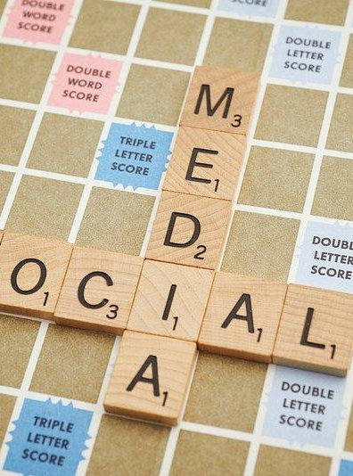
Table of contents
What is Social Media Advertising
Benefits of Social Media Advertising
Different types of Social Media Advertising
Steps to run Social Media Ad Campaign
Social Media Advertising Examples
What is Social Media Analytics
Benefits of Social Media Analytics
Best tools for Social Media Analytics
Social Media Analytics Examples

Slide 3
Social media advertising
Social media advertising is a type of digital marketing strategy that uses social networks, such as LinkedIn, YouTube, Facebook, X (formerly Twitter), TikTok and Instagram, to deliver paid ads to your target audience.
A social media ad campaign is a quick and effective way to improve your brand or product.
More and more companies rely on social media ads to grow their business and attract prospective customers

Slide 4

Benefits of Social Media Advertising
1: Achieve a wider reach
With social media ads, you can cast a wide net, helping you reach not just your current followers but also potential customers who meet your demographic criteria. This means your brand can break into new markets and expand its reach in ways that traditional advertising might struggle to match.

Slide 5
2: Refine your target audience
Reach your ideal target audience — potential leads who have visited your website, customers who have previously purchased from your brand and prospects who are interested in your brand’s products or services. layered targeting helps you target your audience with pinpoint accuracy. Whether it's age, location, interests or online behavior, you can customize your ads to reach the right people at the right time.
3: Improve engagement
Social media platforms are all about interaction. When you run ads, you're not just publishing yet another content. You're creating opportunities for meaningful engagement with your audience. Whether it's likes, comments, shares or clicks, social media ads encourage your audience to act and connect with your brand.

Slide 6
4: Attain measurable business outcomes
One of the standout benefits is the ability to track and measure your ad performance in real time. You'll know exactly how many people saw your ad, clicked on it and even made a purchase. Along with this insight, you can also gauge how different ad elements like content, design and call to action perform. Thus, providing you with the necessary data to fine-tune your campaigns for optimal results, saving you time and money.
2: Save a considerable amount of money
Social media advertising costs a fraction of what you generally spend on traditional advertising methods. You can set your budget upfront; most social platforms offer flexible options to help you make the most of your investment. This affordability has made social media advertising a popular choice for businesses of all sizes.

Slide 7

Different types of Social Media Ads
Linkedin -
Sponsored Content
Sponsored inMail
Dynamic Ads
Instagram -
In-feed Ads
Stories Ads
Carousel Ads

Slide 8
Different types of Social Media Ads
Facebook
Sponsored Content
Sponsored inMail
Dynamic Ads
X ( formly twitter )-
Promoted tweets
Promoted account
Promoted trends

Slide 9

Steps to run social media campaign
Step 1: Define clear objectives
Begin by defining your campaign's specific goals. Are you aiming to boost brand awareness, generate leads, drive website traffic or increase sales? Having clear objectives will guide your campaign strategy.

Slide 10
Step 2: Know your target audience
Conduct thorough audience research. Understand their demographics (age, gender, location), interests, and online behaviors. This information helps you create content that resonates with your target audience.
Step 3: Choose the right platform
Select social media platforms where your target audience is most active. For example, if you're targeting professionals, LinkedIn might be more effective than TikTok.

Slide 11
Step 4: Create compelling content
Craft ad content that captures attention and conveys your message effectively. Whether it's eye-catching visuals, persuasive copy or engaging videos, ensure your content aligns with your campaign objectives.
Step 5: Set budget and schedule
Determine how much you're willing to spend on your campaign and the timing of your ads. Consider daily or lifetime budgets and schedule ads to maximize their impact.

Slide 12

Step 6: Target effectively
Utilize the advanced targeting options provided by social media platforms. Refine your audience based on factors like demographics, interests, behaviors and even by retargeting previous website visitors.
Step 7: Optimize ad formats
Choose the most suitable ad formats for your campaign objectives. For instance, use video ads for storytelling or image carousels for showcasing multiple products.

Slide 13
Step 8: Monitor and adjust
Keep a close eye on your ad performance. Regularly review metrics such as click-through rates (CTR), conversion rates and return on ad spend (ROAS). Make adjustments along the course to improve results.
Step 9: A/B test the ads
Experiment with different elements of your ads, such as headlines, visuals or calls to action. A/B testing helps you identify which variations perform best.

Slide 14
Step 10: Track conversions
Implement conversion tracking to measure the success of your campaign. Track actions like sign-ups, purchases or form submissions to gauge ROI accurately.
Step 11: Engage with users
Actively engage with users who interact with your ads. Respond to comments, address questions and foster a sense of community around your brand.
Photo by Pexels

Slide 15

Photo by Pexels

Slide 16
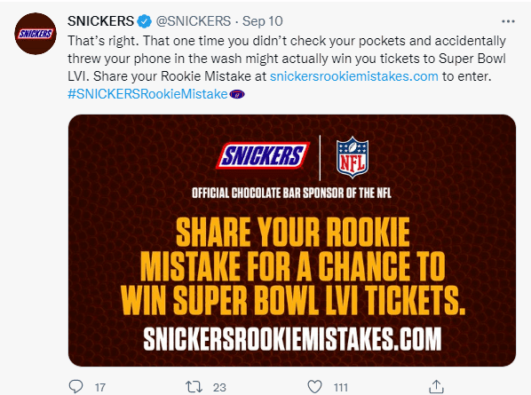
Photo by Pexels

Slide 17
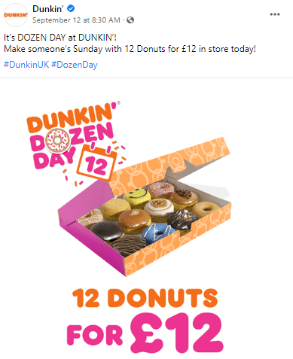
Photo by Pexels

Slide 18

Social Media Analytics
Social media analytics refers to the practice of gathering data from social media platforms and analyzing it — to understand and optimize content performance and engagement.
This involves tracking a multitude of metrics, such as likes, shares, comments and overall reach.
Monitoring trends and patterns can guide future marketing strategies.
Real-time data allows for quick adjustments to improve campaign performance.

Slide 19

Benefits of Social Media Analytics
Identify trends and patterns to refine content and targeting strategies.
Measure the impact of campaigns and optimize marketing efforts.
Enhance customer experience by personalizing content and interactions.
Improve overall business performance through data-driven decisions.

Slide 20

Key Metrics to Track
Reach: Measure the number of people who see your social media content.
Engagement: Track likes, shares, and comments to gauge audience interaction.
Conversion Rate: Monitor the percentage of users who complete a desired action.
ROI: Calculate the return on investment to evaluate campaign effectiveness.

Slide 21
Best tools for social media analytics
Sprout Social
Hubspot
Google Analytics
Hootsuite
Buffer
Native Tools
Facebook Insights
Instagram Insights
Linkedin Insights

Slide 22
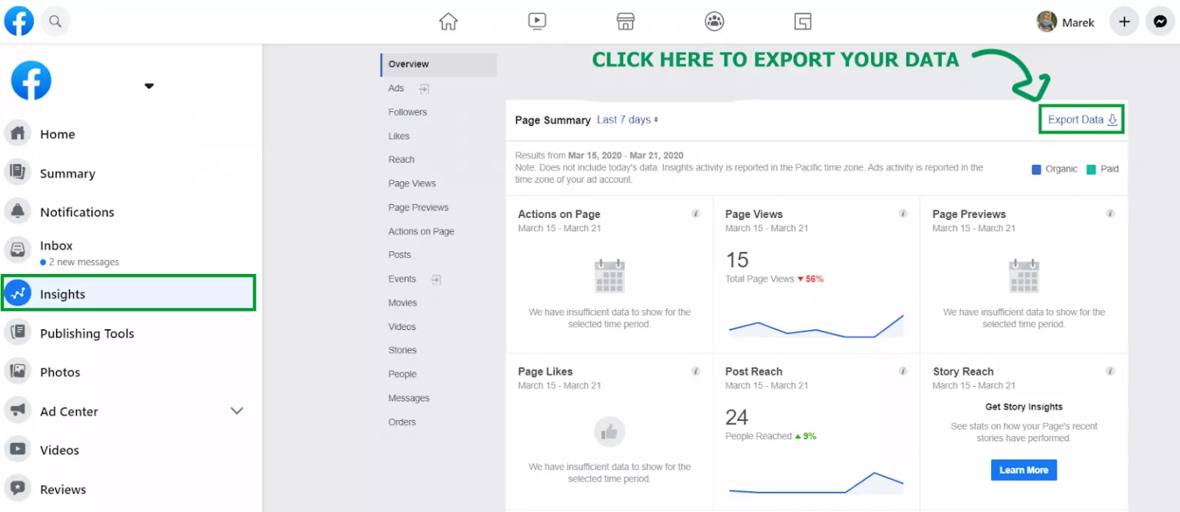
Photo by Pexels

Slide 23
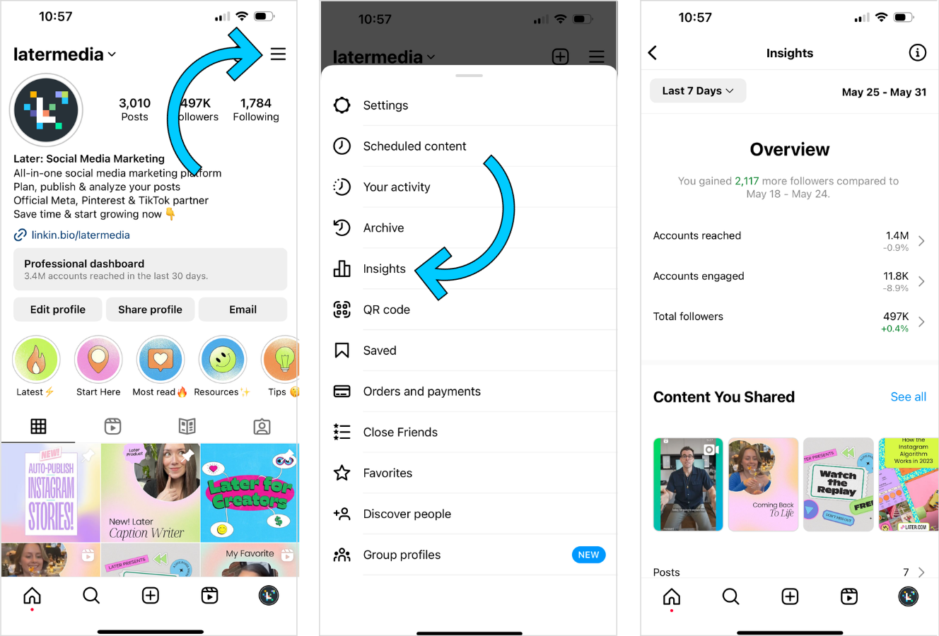
Photo by Pexels

Slide 24
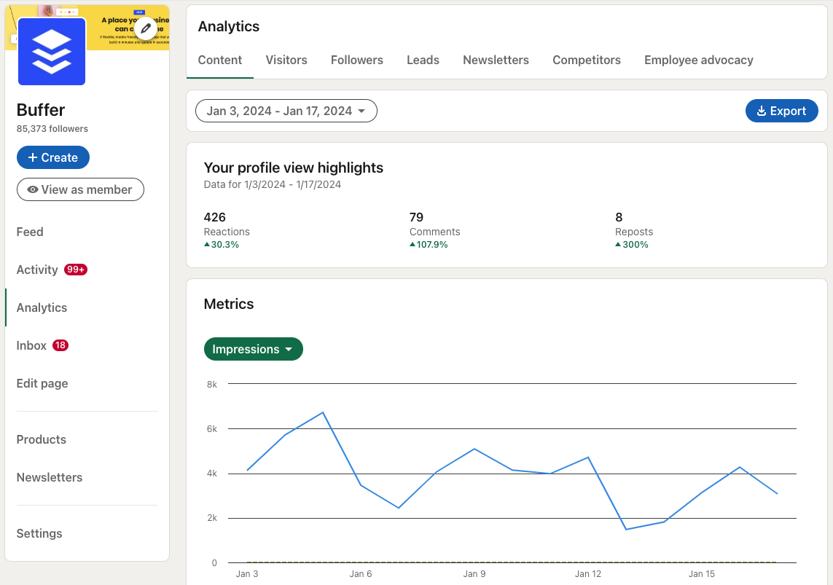
Photo by Pexels

Slide 25
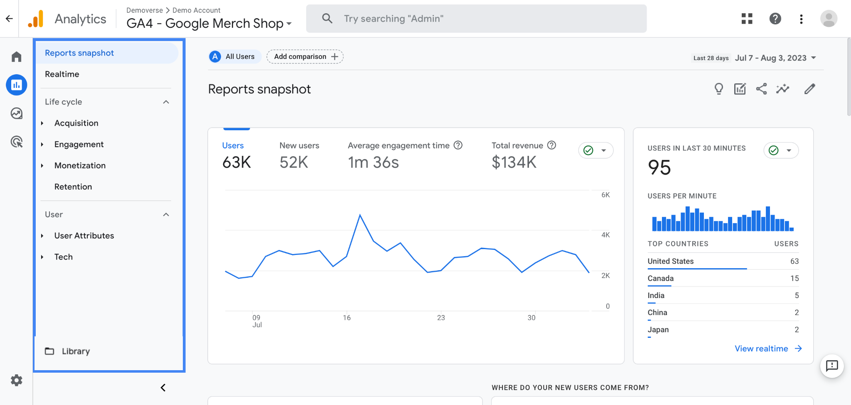
Photo by Pexels

